Slide 1
All IVCs experiments

Slide 2
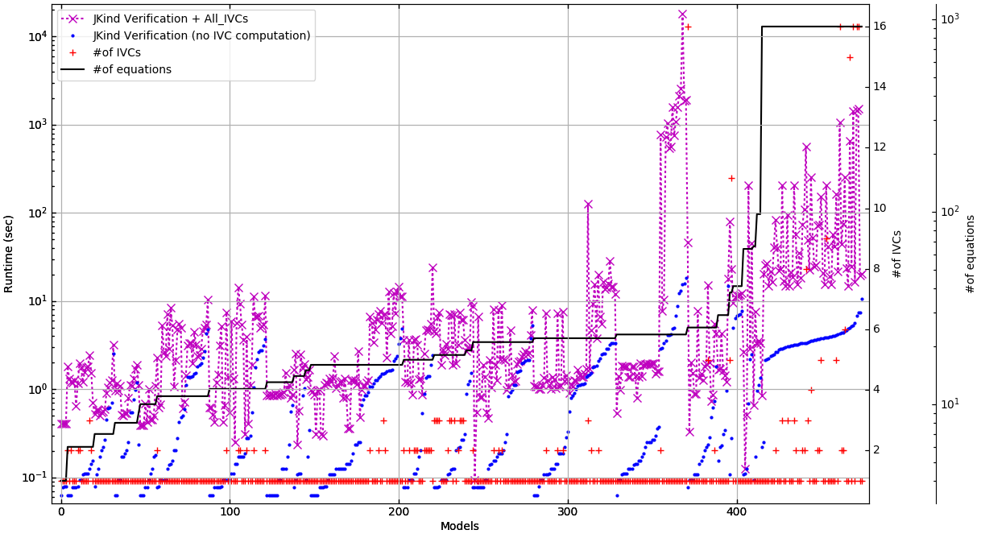
This graph shows the time AIVC takes vs the size of file and number of IVCs. There are 3 graphs, just different markers. Choose which one you like #1:

Slide 3
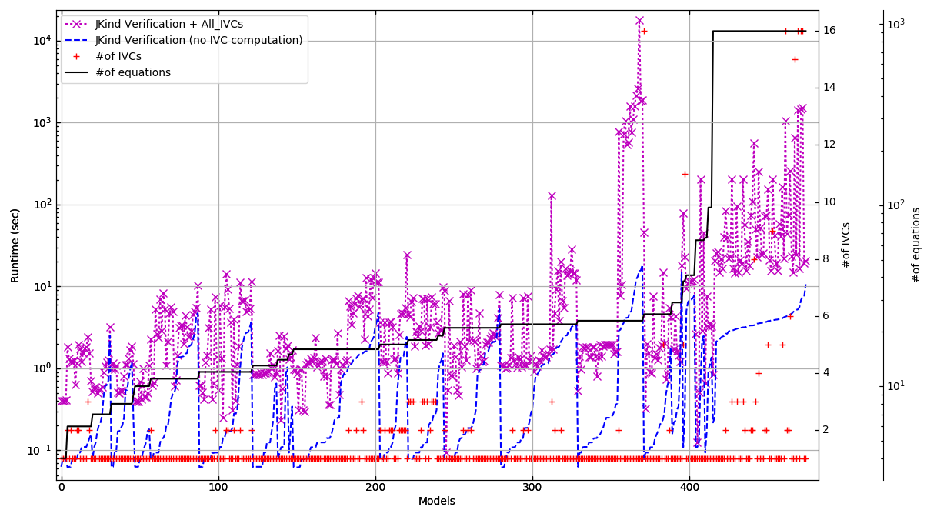
This graph shows the time AIVC takes vs the size of file and number of IVCs. There are 3 graphs, which are the same but just with different markers. Choose which one you like #2:

Slide 4
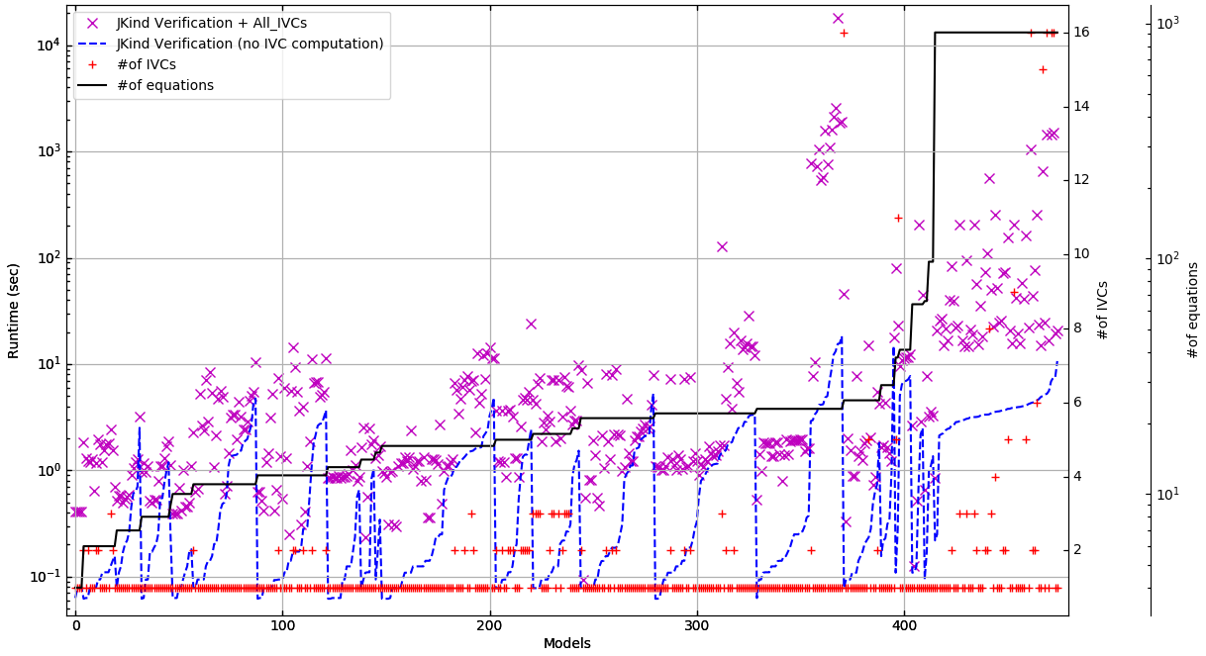
This graph shows the time AIVC takes vs the size of file and number of IVCs. There are 3 graphs, just different markers. Choose which one you like #3:

Slide 5
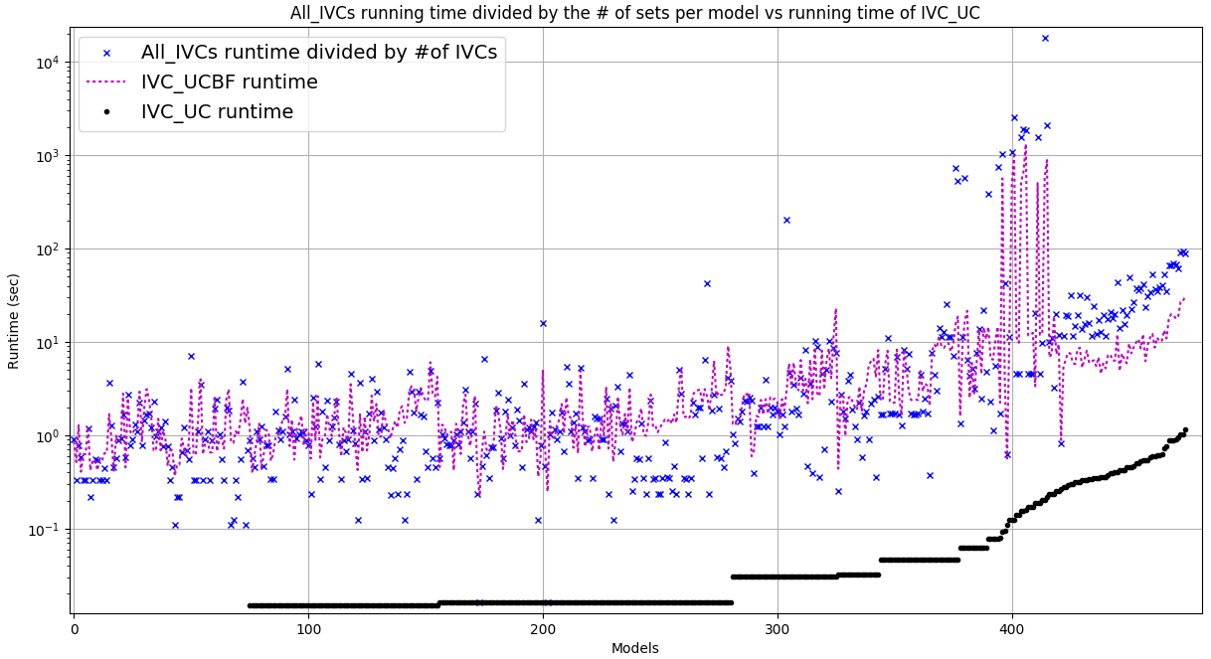
This graph shows the runtime of AIVC divided by the number of IVCs

Slide 6
Size of IVCs
min size of minimum IVCs: 1
max size of minimum IVCs: 134
stdev size of minimum IVCs: 15.5498599009
average size of minimum IVCs: 12.0778947368
min size of minimal IVCs from IVC_UCBF: 1
max size of minimal IVCs from IVC_UCBF: 141
stdev size of minimal IVCs from IVC_UCBF: 16.107382867
average size of minimal IVCs from IVC_UCBF: 12.1852631579
min size of IVCs from IVC_UC: 1
max size of IVCs from IVC_UC: 141
stdev size of IVCs from IVC_UC: 16.000801365
average size of IVCs from IVC_UC: 12.7536842105
min size of IVCs from All_IVCs: 1
max size of IVCs from All_IVCs: 159
stdev size of IVCs from All_IVCs: 1.16837074951
average size of IVCs from All_IVCs: 12.4623907496

Slide 7
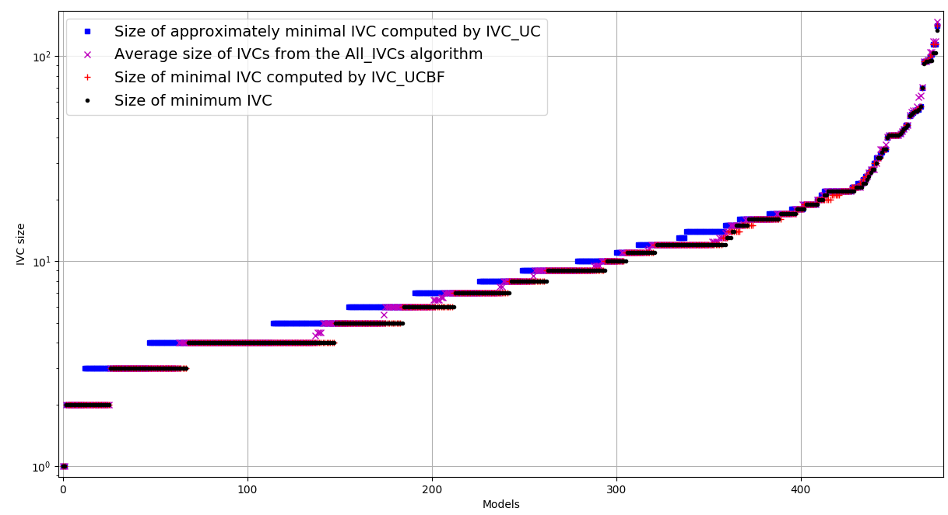
Slide 5,6,7, 8 can explain why we shouldn’t use UCBF in the internal loop

Slide 8
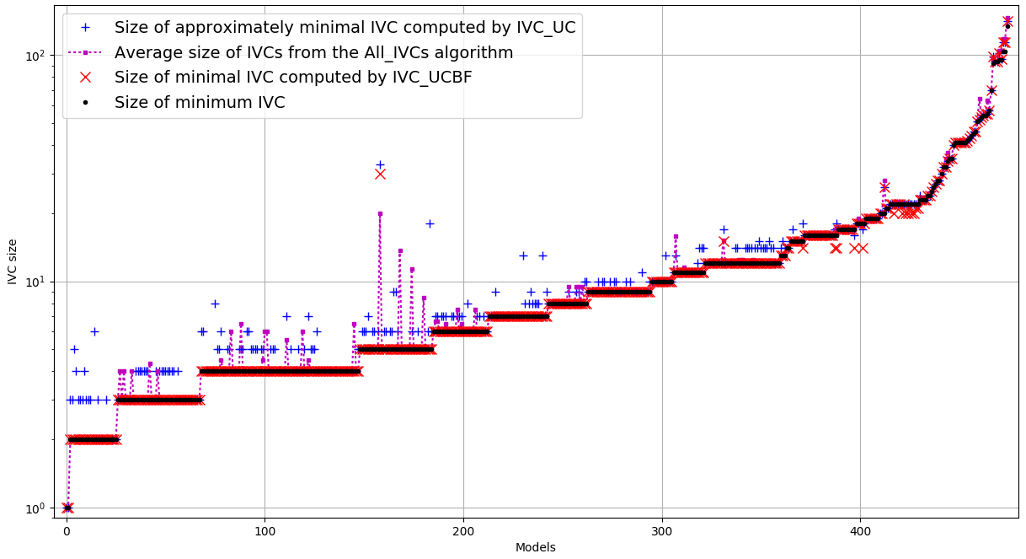
This is the same as previous slide sorted differently as you see in some cases size of UCBF is smaller than the Minimum set found by All_IVCs. I checked those, it’s because of timeouts

Slide 9
Now performance
I have different pictures sorted based on runtime of different algorithms
Sometime for the same data, I used different markers; in those cases, please tell me which one you prefer [delete those you don’t like, and give me back the slides ☺]
I think in the experiments, we should show all the different pictures of running time sorted based on different algorithms (see the pictures) something like slide 14

Slide 10
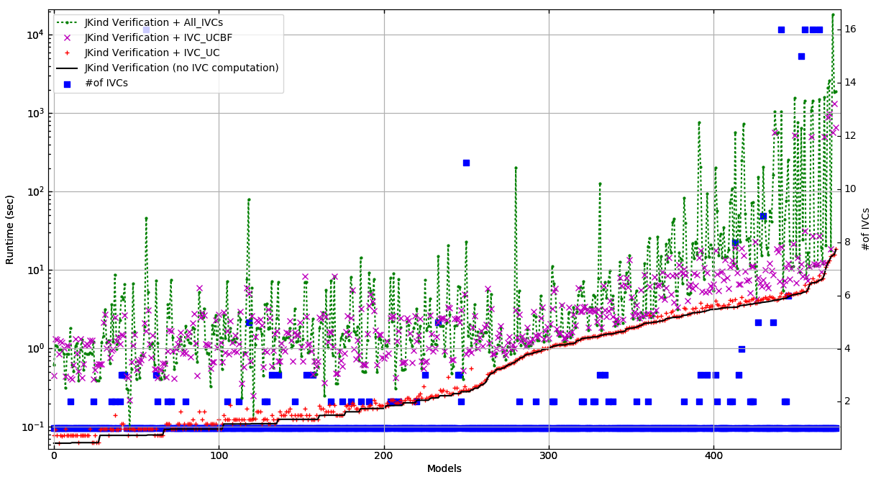
These are performance pics, sorted based on proof-time, #1:

Slide 11
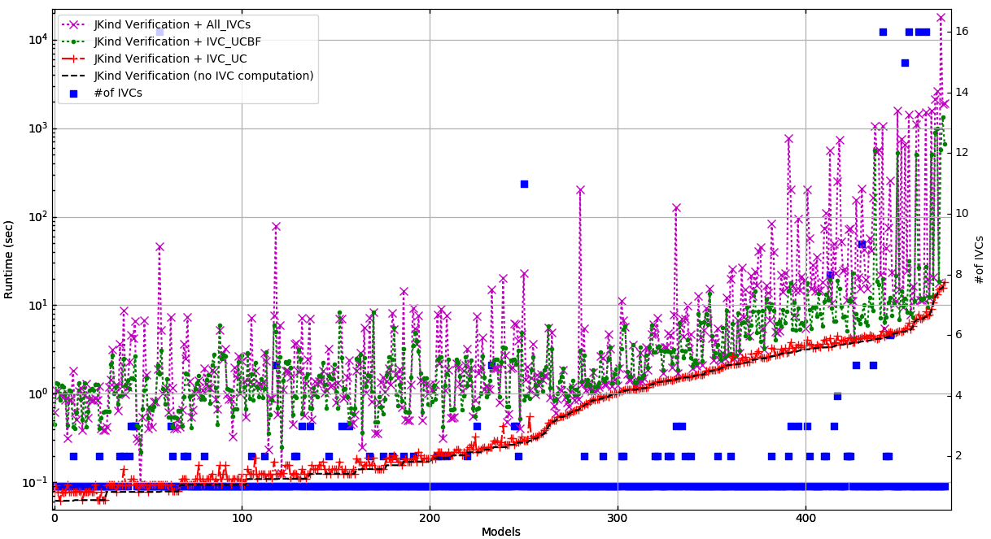
These are performance pics, sorted based on proof-time, #2:

Slide 12
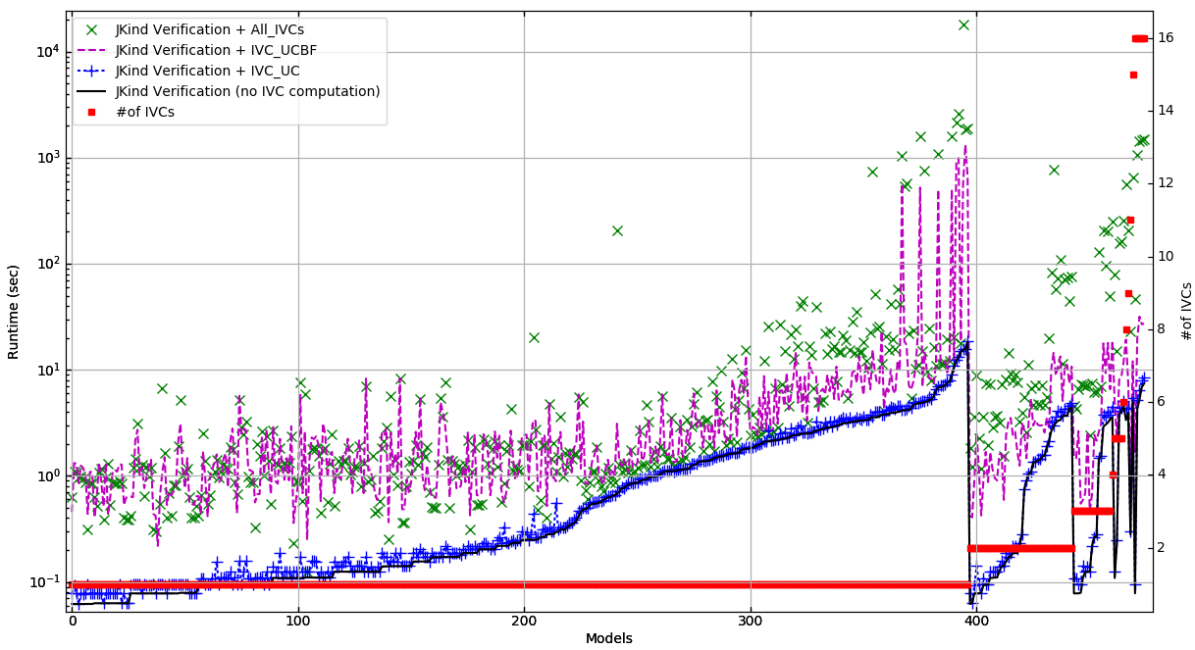
These are performance pics, sorted based on number of IVCs

Slide 13
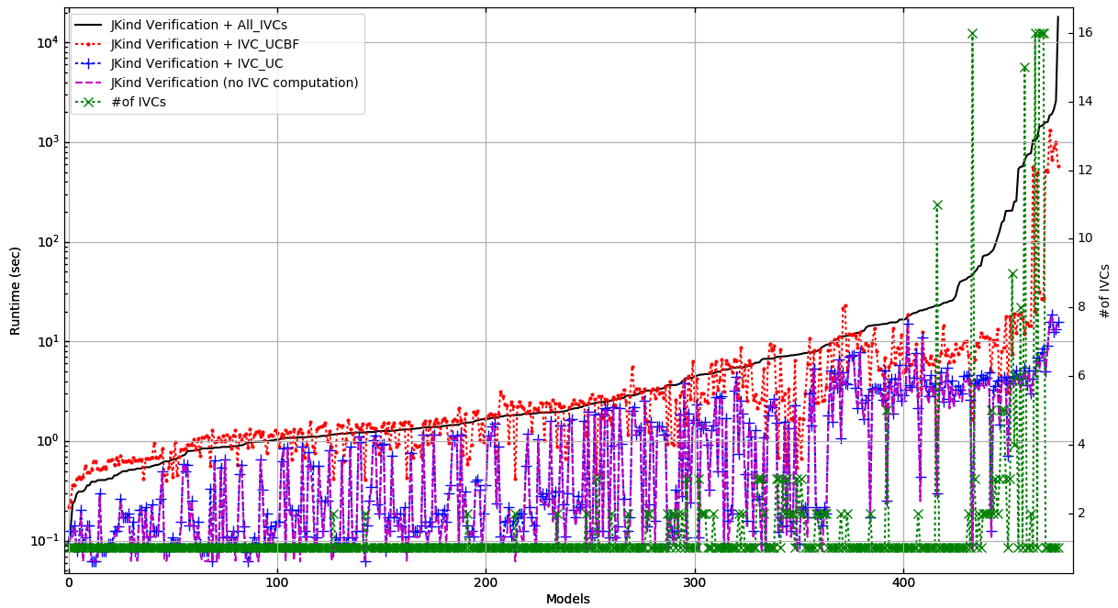
These are performance pics, sorted based on AIVC time, #1:

Slide 14
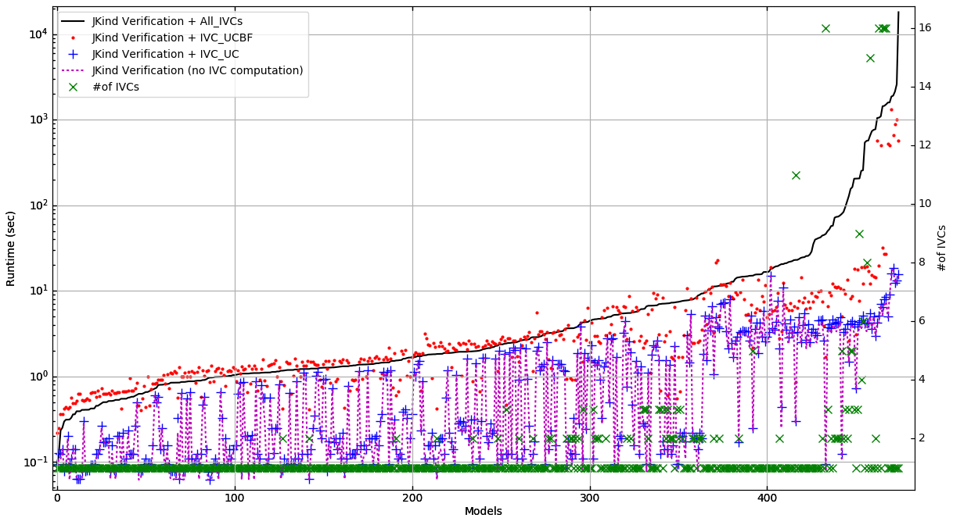
These are performance pics, sorted based on AIVC time, #2:

Slide 15
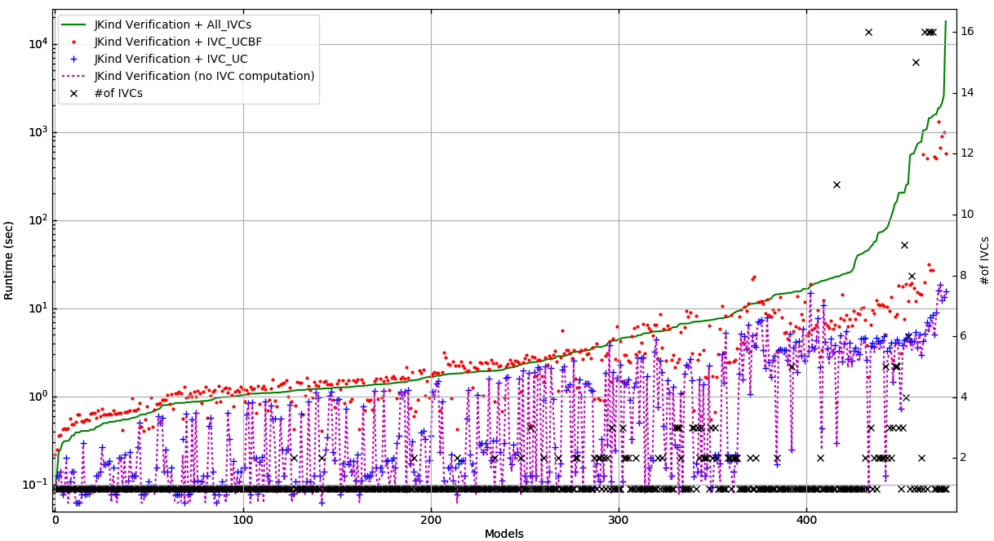
These are performance pics, sorted based on AIVC time, #3:

Slide 16
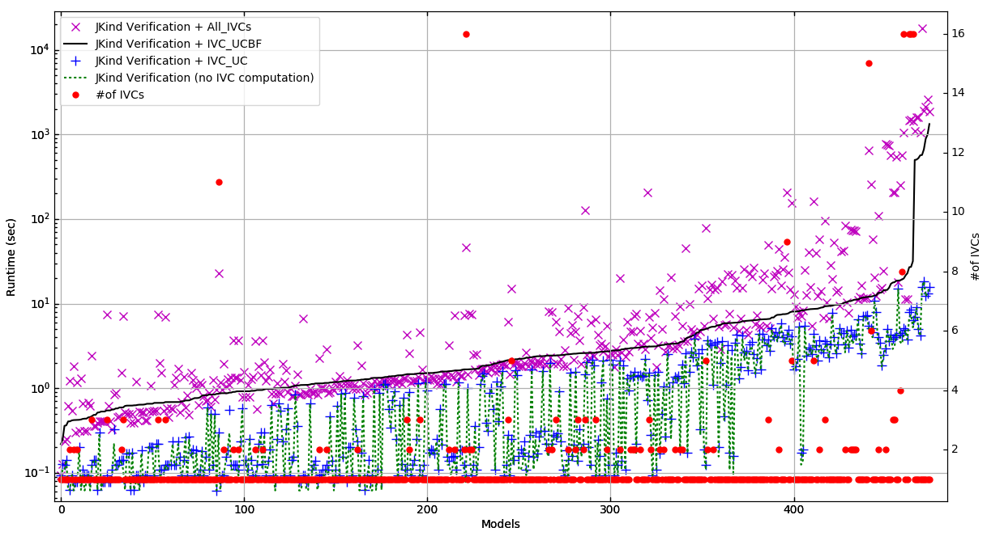
These are performance pics, sorted based on UCBF time

Slide 17
Something like this for performance

Slide 18
Finally, I can’t think of a good reason to bring up jaccard distance
In the first paper, it made some sense, but here I don’t know. If you want to show there are cases with different sets, the performance pics show that
But, let me know if you have RQs that can be answered by Jaccard distance
Also let me know if there are more RQs
Thanks ☺

